Slide 1

INTERACTION WITH BMC CEO
DEVELOPMENT OF INTEGRATED WEARABLE DEVICE FOR REMOTE MONITORING OF PREGNANT WOMEN IN GHANA
^{1st June 2025}

Slide 2
AI MODEL PROGRESS
KEY OBJECTIVES
Train separate models for detecting preeclampsia, and gestational diabetes.
Use real-world medical datasets to analyze health indicators.
Implement a structured machine learning pipeline from preprocessing to evaluation.
Compare different models to find the best-performing approach for each condition.

Slide 3
DATASET OVERVIEW
PREECLAMPSIA
Dataset Name: preeclampsia_dataset.csv
Source: Manually generated
Number of Samples: 10,000
Number of Input Features: 4
Output States: Low, mild or High
Description: Dataset of 10,000 records generated to predict preeclampsia risk (Low, Mild, High) based on diastolic pressure, systolic pressure, MAP and urine protein levels, with added noise to simulate real-world variability.

Slide 4
FEATURES
PREECLAMPSIA
Systolic blood pressure
Diastolic blood pressure
MAP
Protein in urine

Slide 5
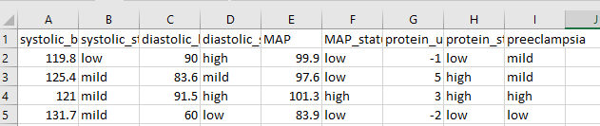
FEATURES
PREECLAMPSIA

Slide 6
THRESHOLD DESCRIPTION
PREECLAMPSIA
SOURCES:
ACOG Practice Bulletin No. 222: Gestational Hypertension and Preeclampsia
NICE_guidance_on-Pre-eclampsia_VB2020
UpToDate: Clinical features and diagnosis of preeclampsia
WHO Guidelines: WHO Recommendations for Prevention and Treatment of Preeclampsia and Eclampsia

Slide 7
DATASET OVERVIEW
GESTATIONAL DIABETES
Dataset Name: Gestational Diabetes 3.csv
Source: Manually generated
Number of Samples: 10,000
Number of Input Features: 4
Output States: Low, mild or high
Description:

Slide 8
FEATURES
GESTATIONAL DIABETES
Blood Glucose level
BMI
Family history
Body Temperature

Slide 9
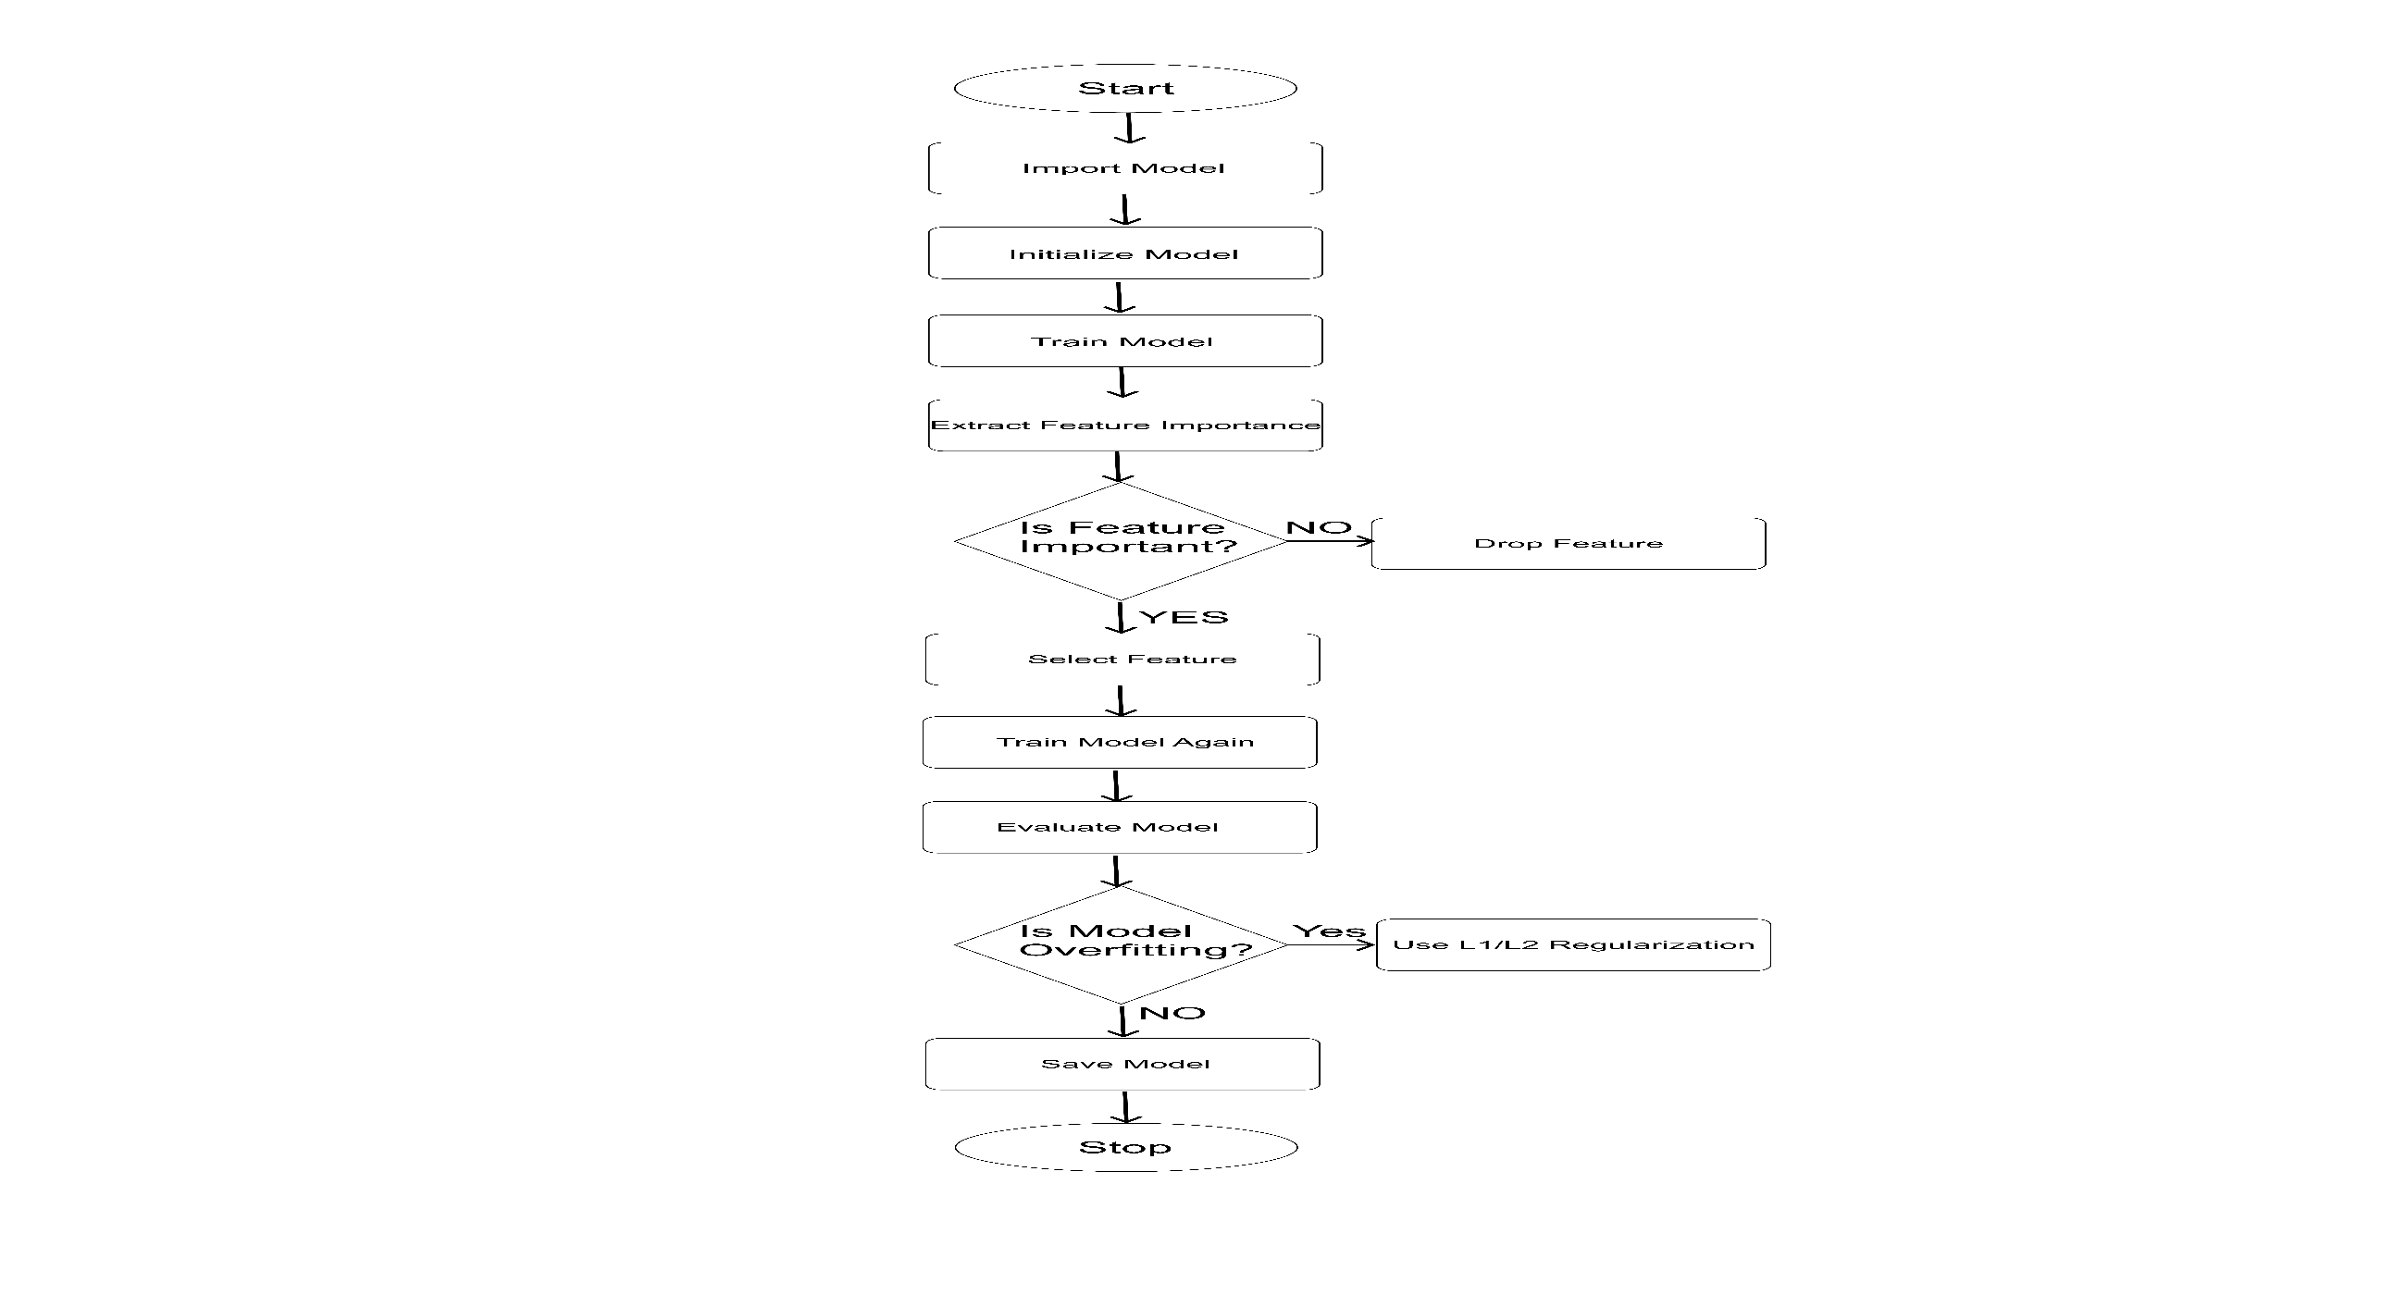
MACHINE LEARNING WORKFLOW

Slide 10
MOBILE APP PROGRESS
Setting up backend functionality for SMS Notifications for:
Medication Reminders
Antenatal Visit Reminder
Daily Pregnancy Tips Based on Subsription or Not
2) Implemention other layers of authentication and security measures using facial recognition and PINs

Slide 11
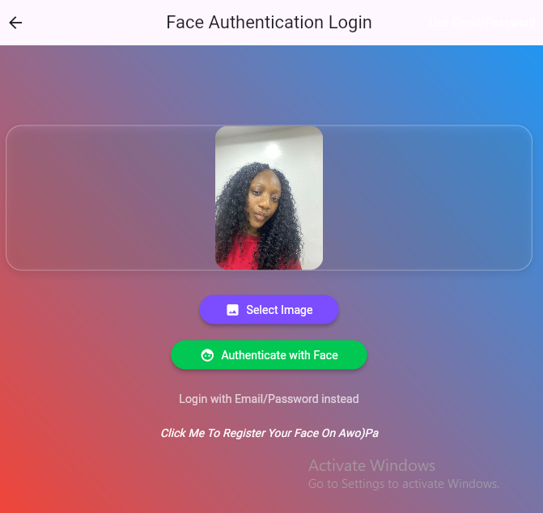
PREGNANT WOMAN

Slide 12
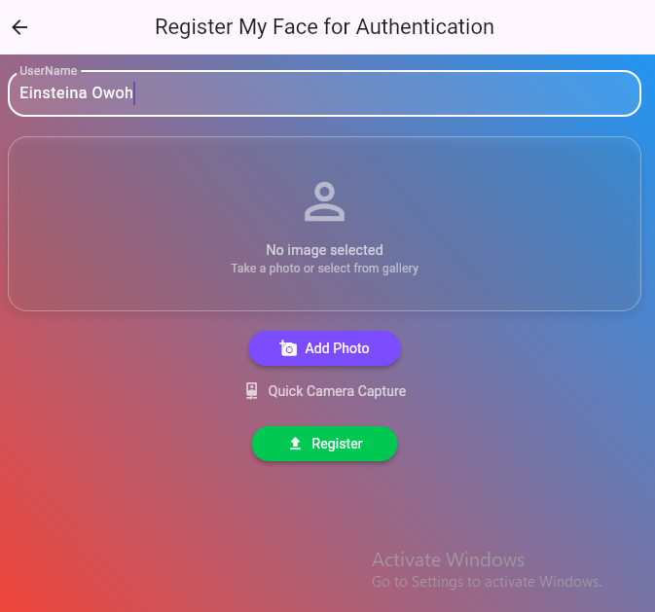
PREGNANT WOMAN

Slide 13
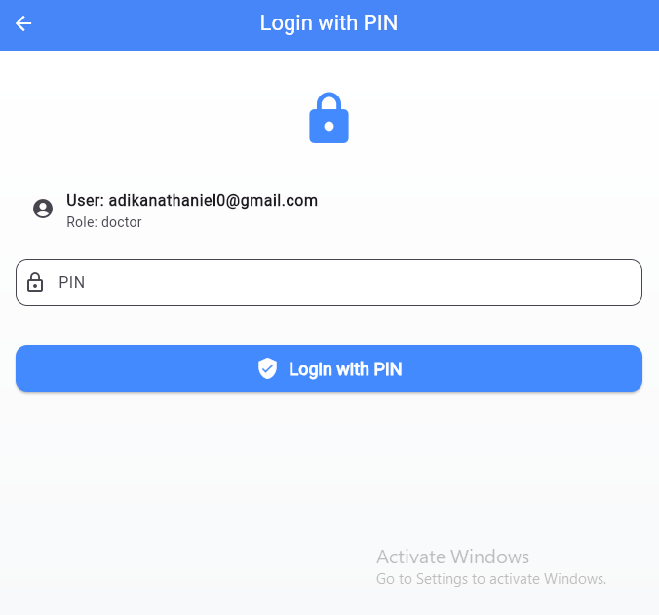
PREGNANT WOMAN

Slide 14
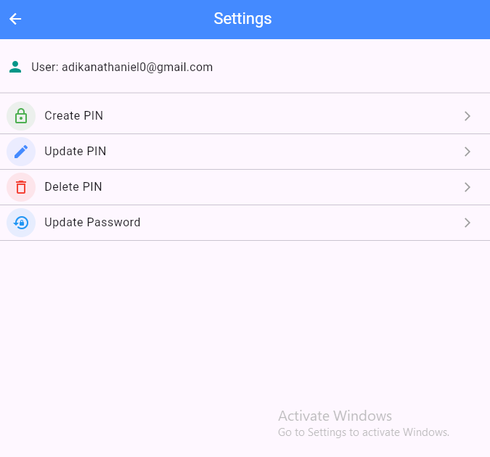
PREGNANT WOMAN

Slide 15
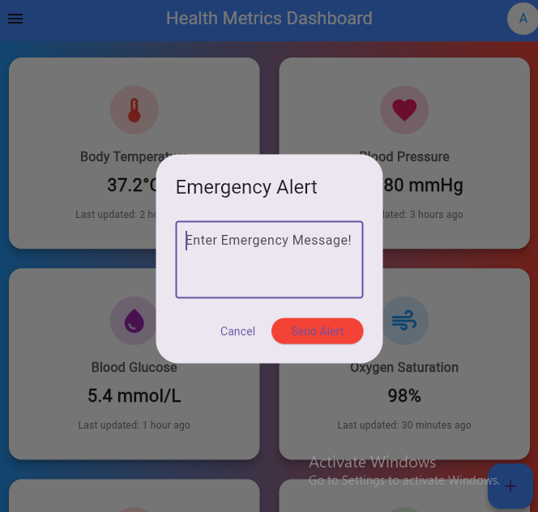
PREGNANT WOMAN

Slide 16
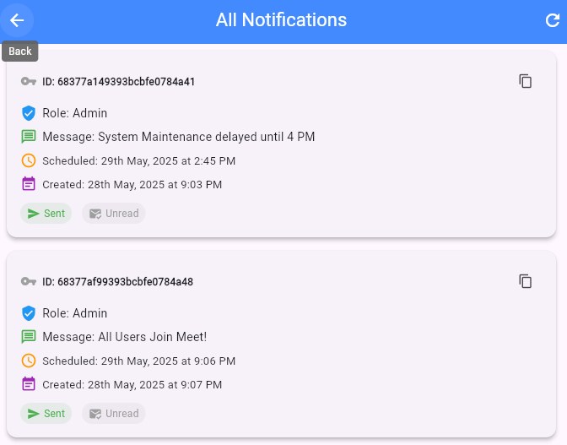
PREGNANT WOMAN

Slide 17
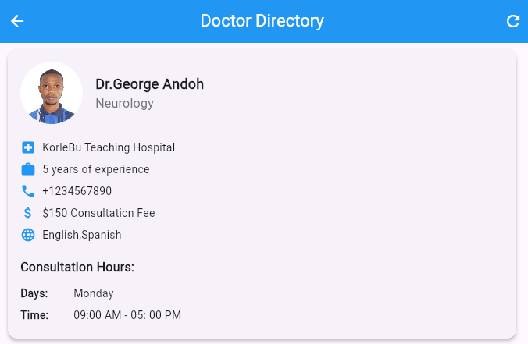
PREGNANT WOMAN

Slide 18
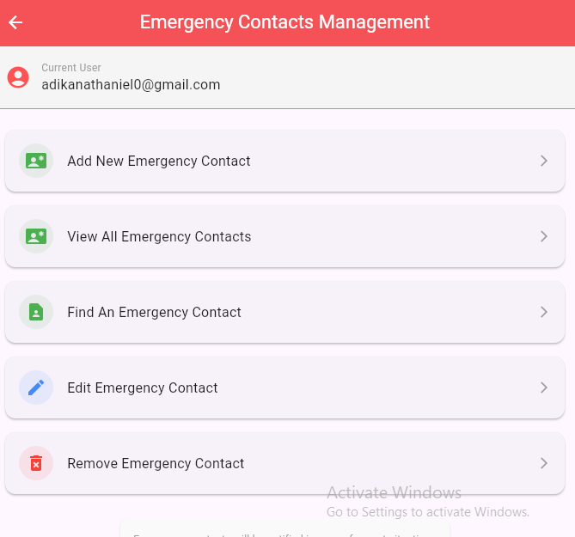
PREGNANT WOMAN

Slide 19
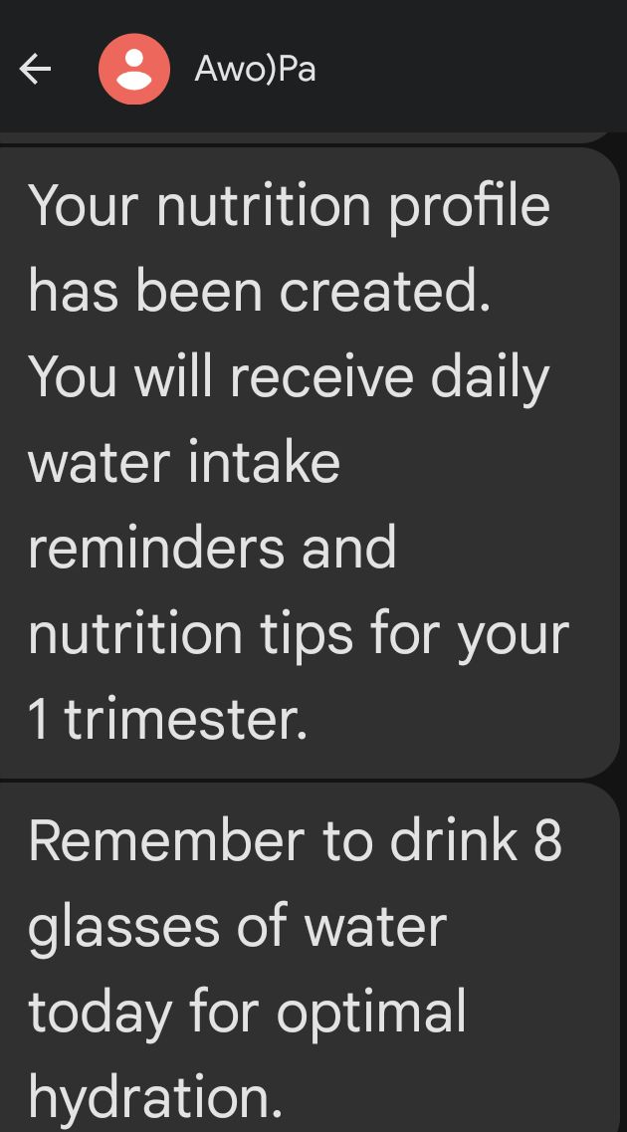
PREGNANT WOMAN

Slide 20
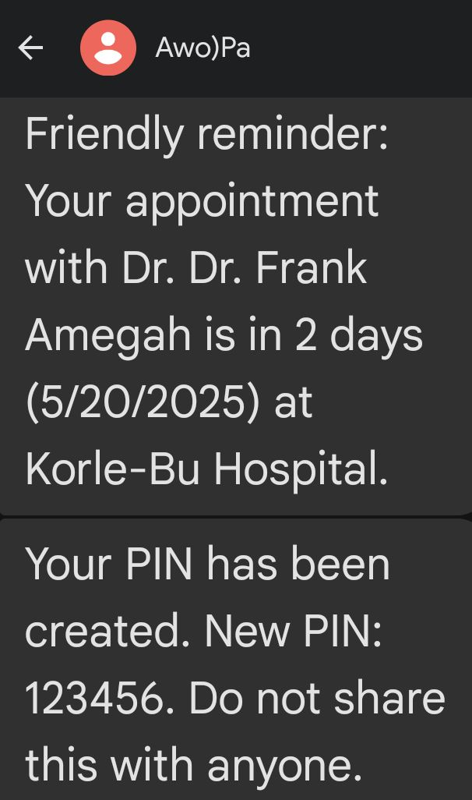
PREGNANT WOMAN

Slide 21
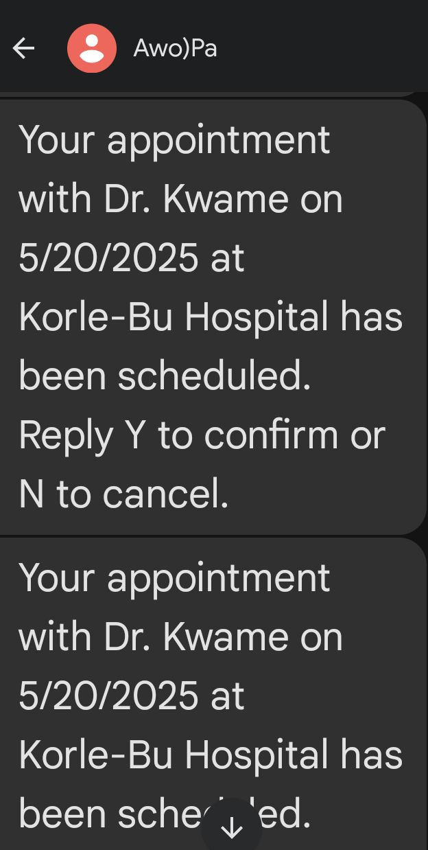
PREGNANT WOMAN

Slide 22
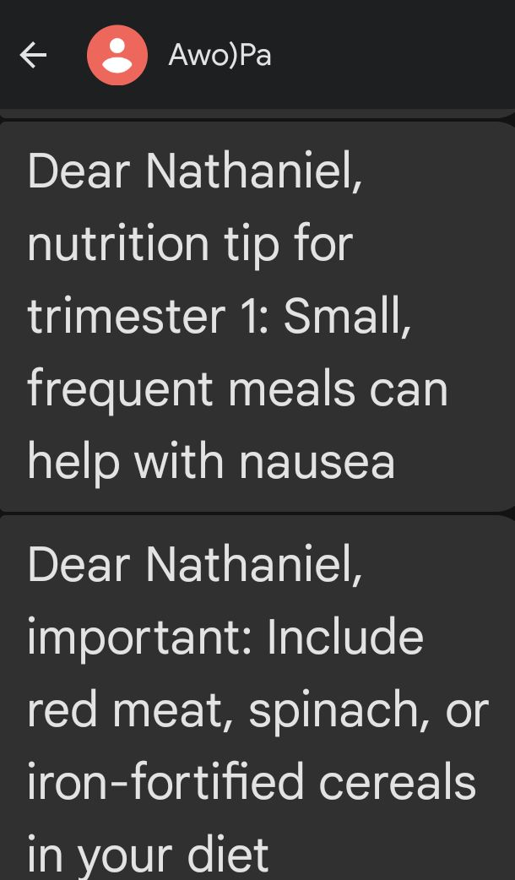
PREGNANT WOMAN

Slide 23
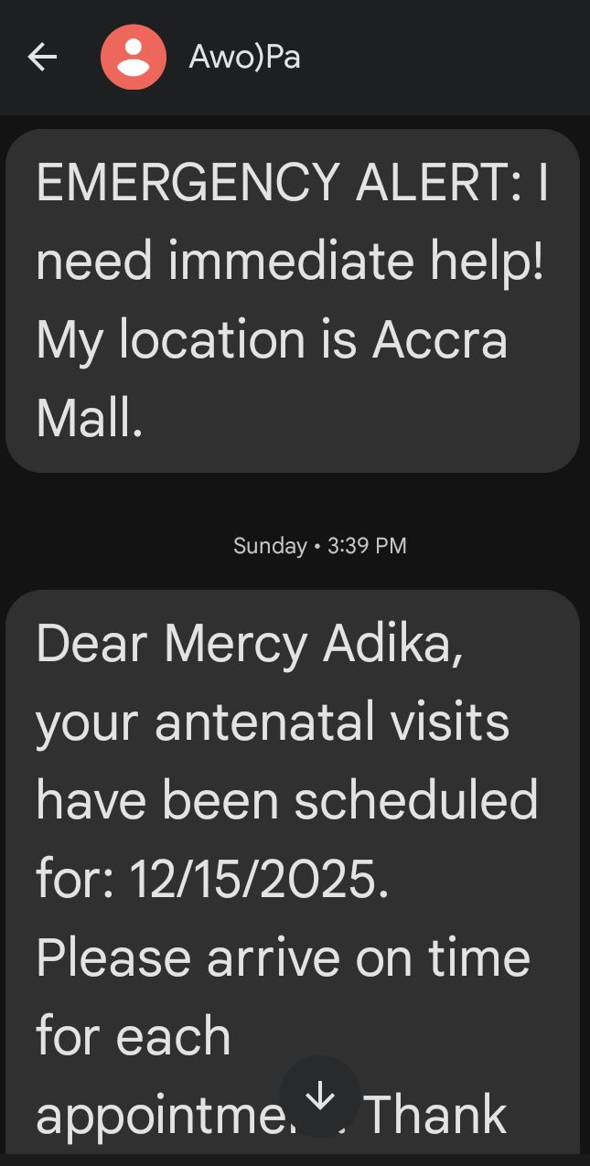
PREGNANT WOMAN

Slide 24
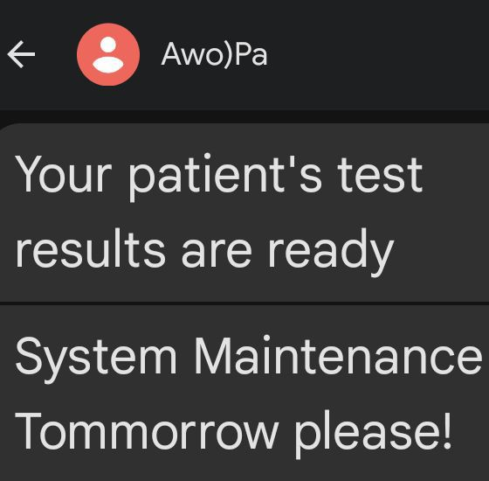
PREGNANT WOMAN

Slide 25
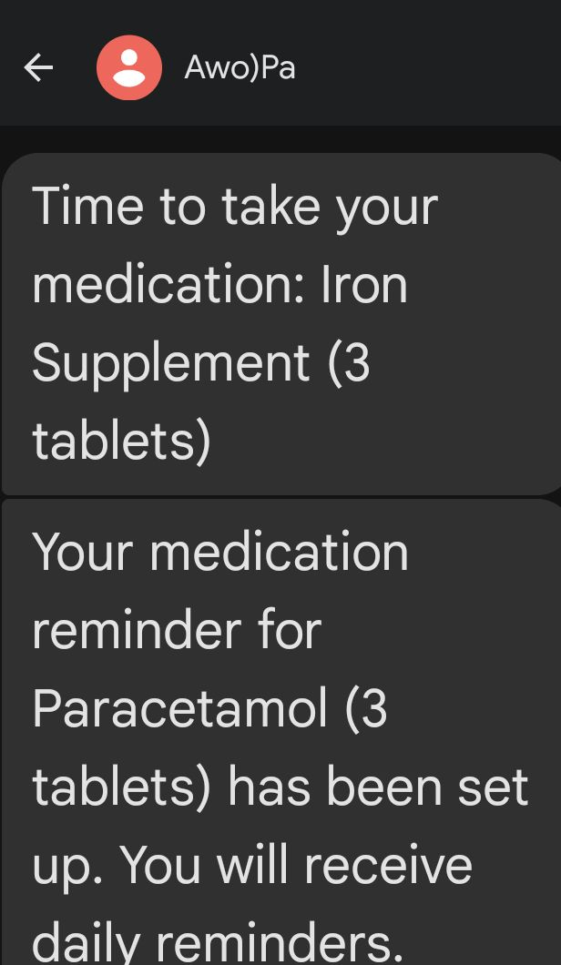
PREGNANT WOMAN

Slide 26
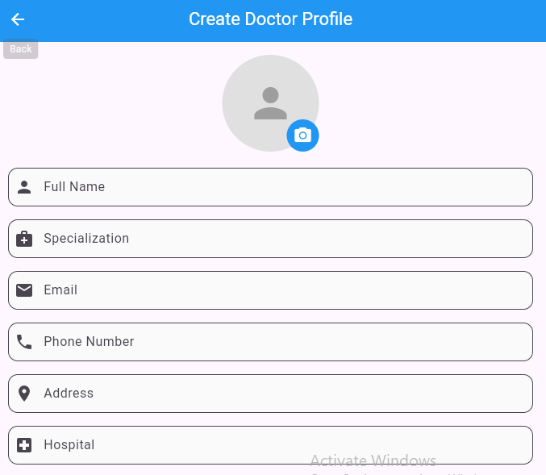
MEDICS

Slide 27
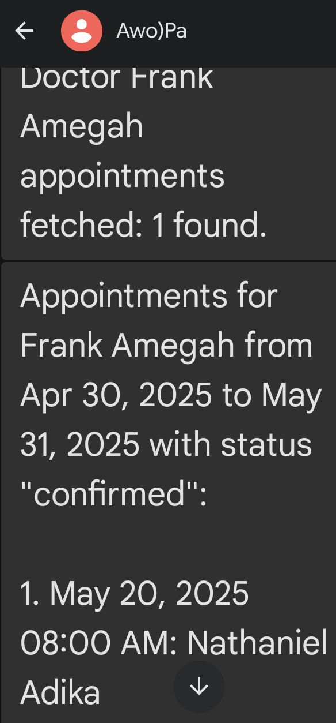
MEDICS

Slide 28
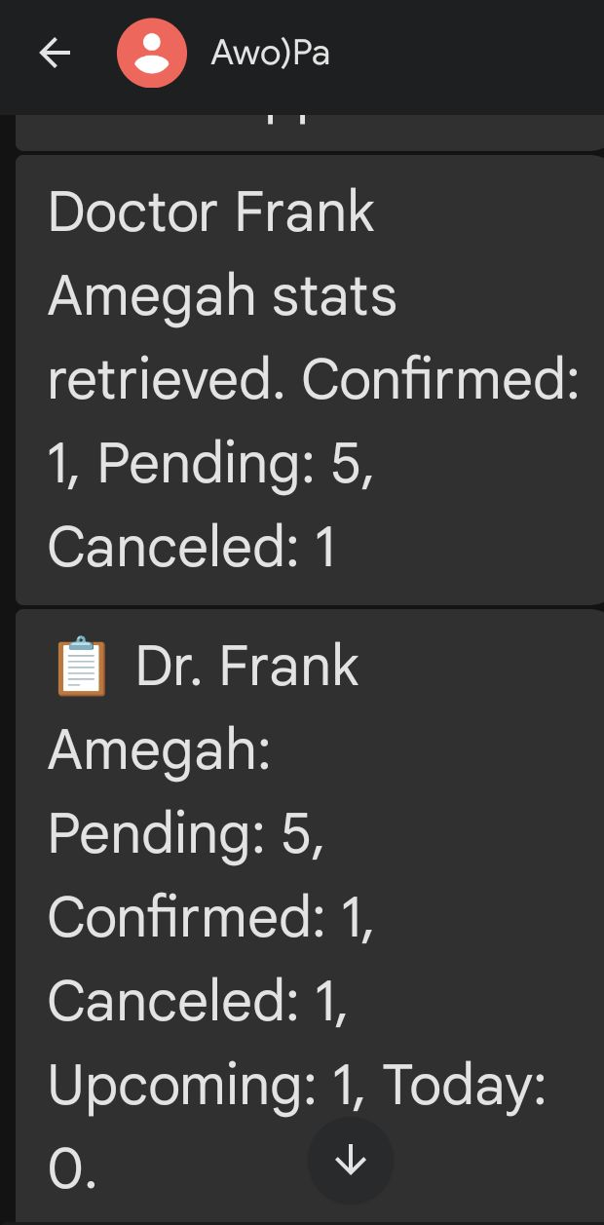
MEDICS

Slide 29
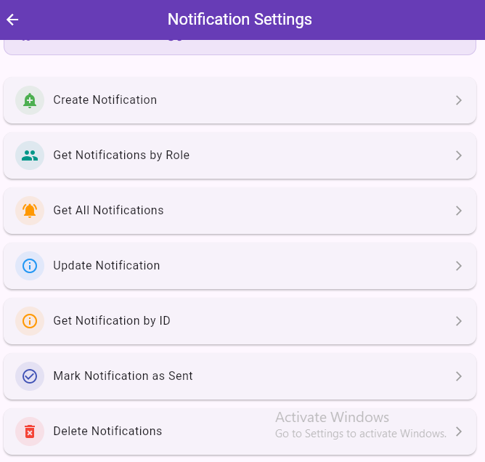
ADMIN

Slide 30
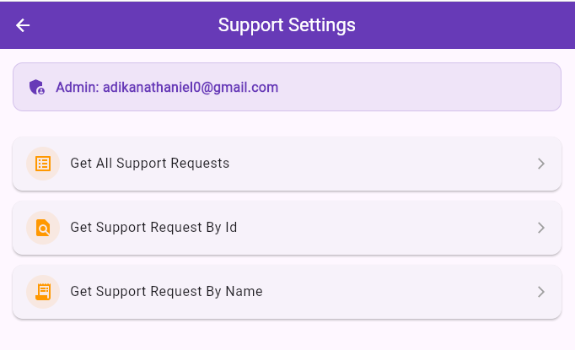
ADMIN

Slide 31
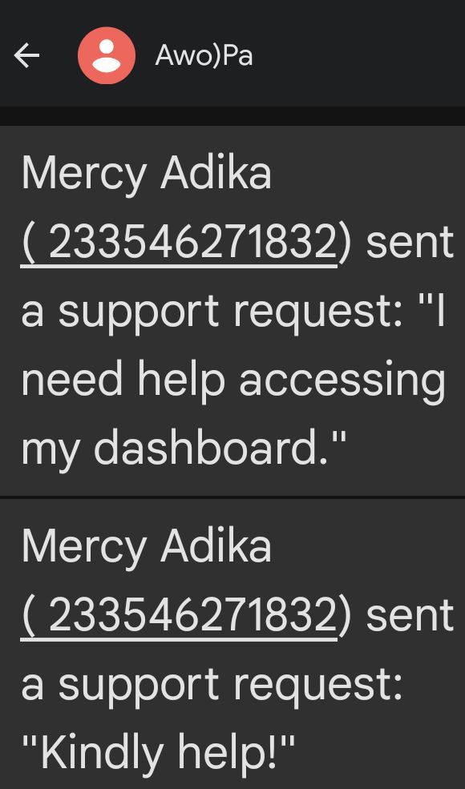
ADMIN

Slide 32
MISCELLANEOUS
QUESTIONS/FEEDBACK

